Slide 1
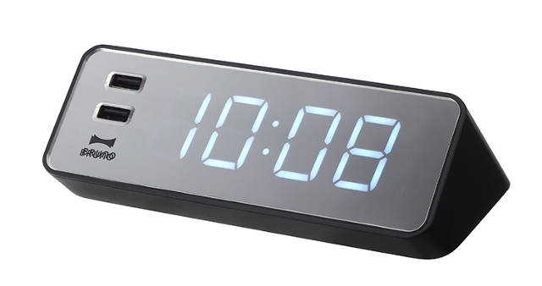
WOLKITE UNIVERSITY ELECTRICAL AND COMPUTER ENGINEERING
DIGITAL CLOCK
SECTION C GROUP 3 AND 10

Slide 2
MAIN TOPICS
Introduction
Feedback of current digital clocks
Use of independent LED matrix digital wall
An extensive range of large space
Displays only hour and minute
Not easy to maintain
Very costly
Significance of the project

Slide 3
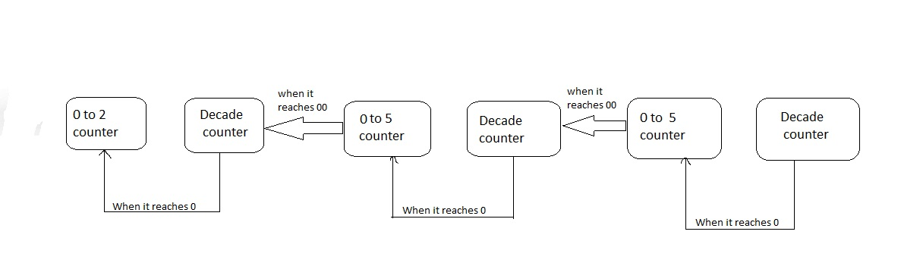
Over all working principles of the project

Slide 4
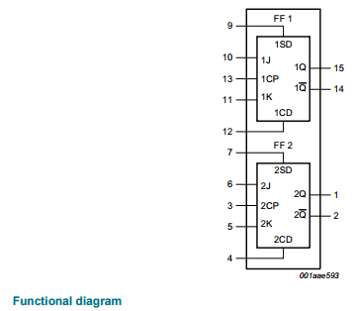
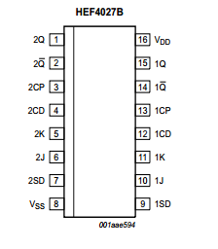
Minute and second counter
Decade counter
Step 1 deciding the type and number of flip flops
Features and benefits of HEF4027B
Fully static operation
5 V, 10 V, and 15 V parametric ratings
Standardized symmetrical output characteristics
Specified from −40 °C to +85 °C
Complies with JEDEC standard JESD 13-B

Slide 5
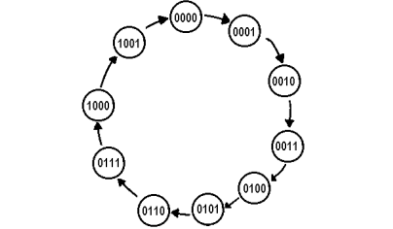
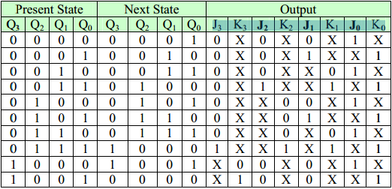
Step 2 Excitation table of JK flip flop
Initial state | Next state | J | K
0 | 0 | 0 | X
0 | 1 | 1 | X
1 | 0 | X | 1
1 | 1 | X | 0
Step 3 State diagram and circuit excitation table

Slide 6
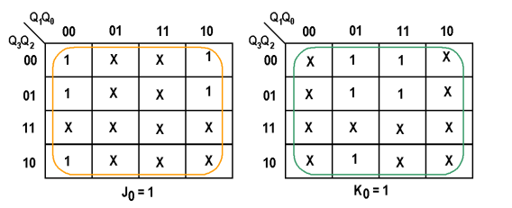
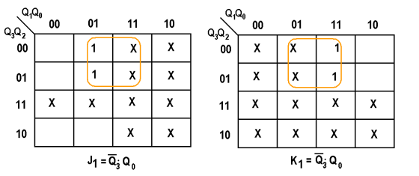
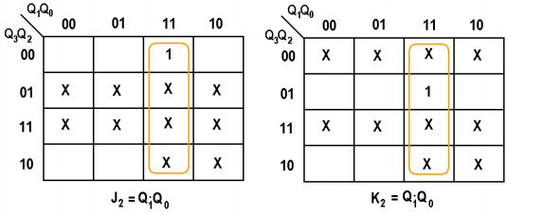
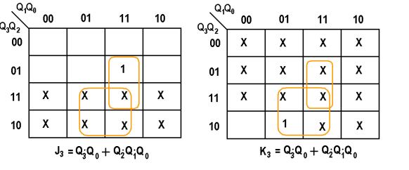
Step 4 obtain simplified equation using k map
The Karnaugh maps of the output J0, K0, J1, K1, J2, K2, J3, and K3

Slide 7
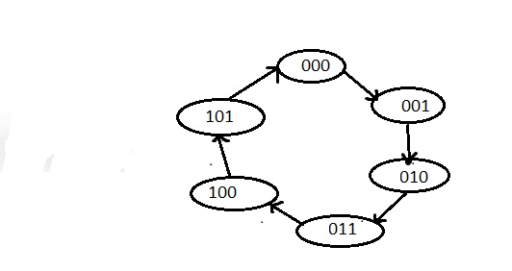
Module 6 (0-5) counter
Step 1 Decide the type and the number of flip flops
Step 2 state diagram and circuit excitation table
Initial state | Final state | J2 | K2 | J1 | K1 | J0 | K0
000 | 001 | 0 | X | 0 | X | 1 | X
001 | 010 | 0 | X | 1 | X | X | 1
010 | 011 | 0 | 0 | X | 0 | 1 | X
011 | 100 | 1 | 1 | X | 1 | X | 1
100 | 101 | X | 0 | 0 | X | 1 | X
101 | 000 | X | 1 | 0 | x | x | 1

Slide 8
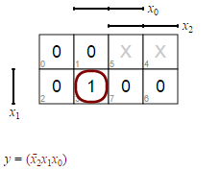
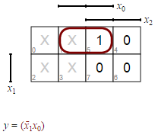
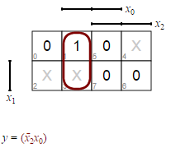
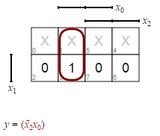
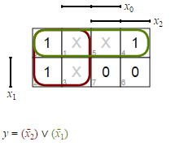
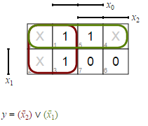
For J2 and K2
For J1 and K1
For Jo and Ko

Slide 9
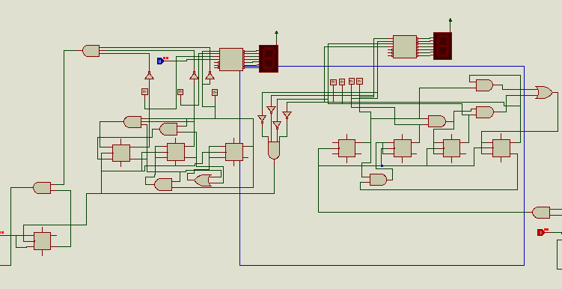

Slide 10
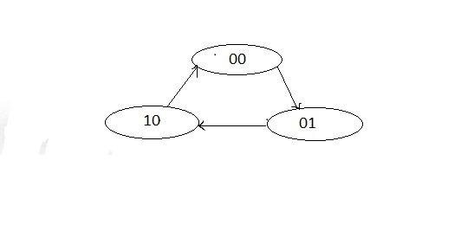
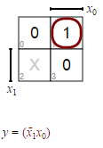
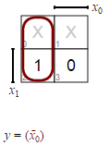
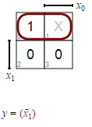
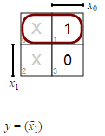
The hour counter
The 0 to 2 counter
Step 1 decide the number of flip flops.
Step 2 state diagram and circuit excitation table.
Initial state | Final state | J1 | K1 | Jo | Ko
00 | 01 | 0 | X | 1 | X
01 | 10 | 1 | X | X | 1
10 | 00 | X | 1 | 0 | X
Resolving k map for the outputs
For J1, K1, Jo, Ko respectively

Slide 11
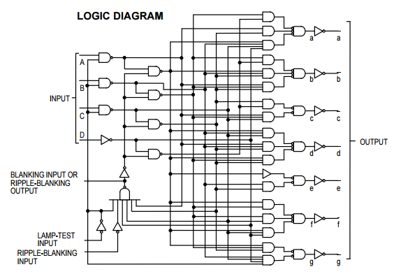
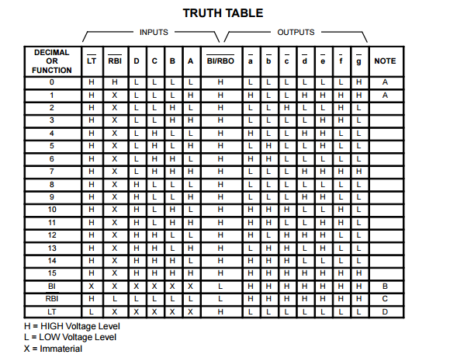
BCD to 7 segment decoder

Slide 12

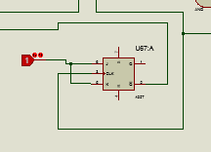
The glitch pulse
Circuit to resolve the glitch

Slide 13
Thanks f r watching

